Slide 1
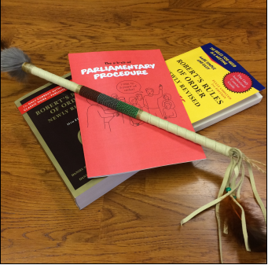
Better Board Meetings: Roles, Procedures & Tips
by: Alan Bojorquez
Central Texas Council of Governments
Municipal Law Training 2017
December 8, 2017

Slide 2
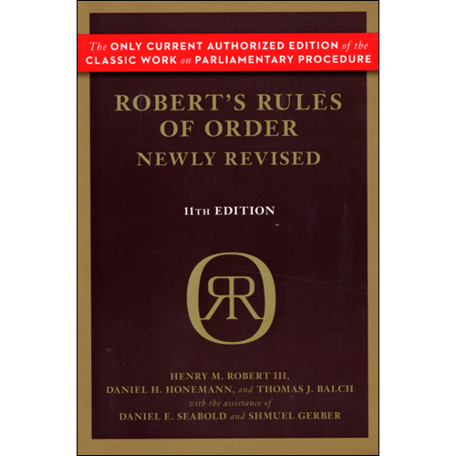
Overview
Players
Role Clarification
Rules of Procedure
Order of Meeting
Traits for Success
Best Practices

Slide 3
Boards
City Council
Planning & Zoning Commission
Economic Development Corporation
Boards, Committees & Task Forces
Resolution
Ordinance
Executive Order
Charter

Slide 4
Who Are The Players?
City Officials (elected, staff, volunteers, contractors)
Citizens (residents, owners, tourists, business owners, workers, civic leaders)
Special Interest Groups
Regulators (state, federal, local)
Media
Utilities / Political Subdivisions / Districts
Neighboring Communities (region)
Judiciary

Slide 5
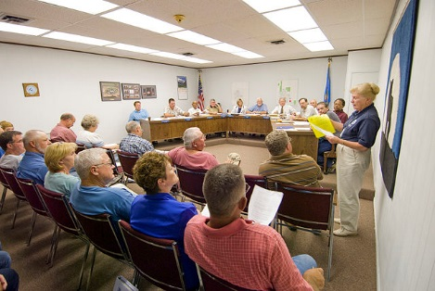
Roles
Chair
Members
Staff
Applicants
Audience
Media
Experts / Consultants

Slide 6
Role Clarification
Legislator
Representative
Executive
Administrator
Advisor / Counselor / Consultant
Advocate
Commentator
Subject Expert
Information Gather
Observer
Tribal
Council
Circle

Slide 7
Common Problems
Too many speaking at once
Conversation strays off topic
Feelings get hurt
Uncertainty of purpose
Confusion
Different understandings of the outcome
What happened?
What did we do?

Slide 8
Rules of Order
Purpose of meeting: To conduct business
Maintenance of Decorum
Should be conducted in a manner that is fair
Vital to the effectiveness, efficiency, and integrity
Order be maintained
Conch
Shell

Slide 9
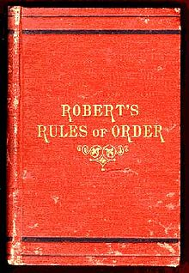
Procedural Rules
Parliamentary Procedure
Date back to ancient Greece
English Parliament
Robert’s Rules of Order
Rare for a board to formally adopt Robert’s rules

Slide 10
Typical Sequence of Meetings

Slide 11
Typical Meeting Sequence
Call to Order, Greeting
Role Call
Invocation, Pledge(s), Proclamations
Public Comment
Agenda Items (Open Session & Executive Session)
Staff Briefing
Applicant (Requestor, Proponent)
Consultant. Expert Testimony
Public Hearing
Motion. Second
Vote
Executive Session: Before / During / End?

Slide 12
Traits of Successful Members
Lead with a Positive Agenda (+)
Embrace all matters before your board
Be open to possibilities (open to discovery)
Be supportive of others
Share Data (don’t hoard info or ambush)
Seek & Build Consensus

Slide 13
What Is Your Function?
Tasks? Anticipated Outcomes? Deliverables?
Problem Identification? Goal-Setting?
Problem-Solving? Visioning?
Listening? (intake)
Legislative (policy formation)
Administrative (implementation)
Adjudicatory (quasi-judicial)
Appellant (appeals, exceptions)

Slide 14
Best Practices
Chair focuses on process (not outcome)
Meetings are for board members 1st
Be respectful
Be fair
Be consistent
Be consistent
Be prepared (do your homework)
If not ready, don’t act
Be strong without being a jerk
Meetings are not a free-for-all

Slide 15
Conclusion

Slide 16
If you like this material,
please follow us on…
@BojorquezLaw
Bojorquez Law Firm
#BojoLaw
Bojorquez Law Firm, PC
#StrongCitiesStrongTexas

